Slide 1
Database
DB

Slide 2
Mysql
Books
  MySQL 5.7 Reference Manual
  MySQL® 5 Certification Study Guide
  Beginning MySQL
  Expert MySQL
  Pro MySQL
  MySQL in a Nutshell
  Sams-Mysql
  SQL for MySQL Developers
  MySQL Cookbook

Slide 3
Mysql Intro.
Over the years, as the demands for information have grown, so too have the database systems that have attempted to meet these demands. However, along with this evolution, we have seen an increase in the costs associated with storing data as well as an increase in the demand for products that can run on multiple platforms and can be optimized based on the needs of specific types of organizations. In response to this changing climate, MySQL has emerged as the most popular open-source database management system (DBMS) in the world. Consequently, organizations everywhere are jumping on the MySQL bandwagon, increasing the demand for those who know how to use MySQL to manage data and those who know how to create applications that can access data in MySQL databases.
In learning to use MySQL, whether to work directly in the MySQL environment or create data-driven applications, an individual should have a thorough understanding of how MySQL, as a relational database management system (RDBMS), allows you to manage data and support applications that rely on access to MySQL data.
Beginning MySQL <number>

Slide 4
Mysql Intro.
As with other RDBMS products, MySQL provides you with a rich set of features that support a secure environment for storing, maintaining, and accessing data. MySQL is a fast, reliable, scalable alternative to many of the commercial RDBMSs available today. The following list provides an overview of the important features found in MySQL:
Scalability: MySQL can handle large databases
Portability: MySQL runs on an assortment of operating systems
Connectivity: MySQL is fully networked and supports TCP/IP sockets, Unix sockets, and named pipes.
Security: MySQL includes a powerful system to control access to data.
Speed: MySQL was developed with speed in mind.
Ease of use: MySQL is simple to install and implement.
Open-source code: MySQL available to everyone to download and use.
Beginning MySQL <number>

Slide 5
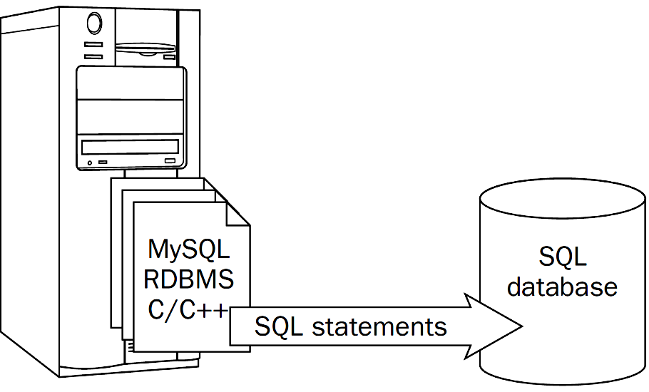
Mysql Intro.
What is SQL?
SQL is, above all else, a computer language used to manage and interact with data in a relational database. SQL is the most universally implemented database language in use, and it has become the standard language for database management. SQL works in conjunction with a RDBMS to define the structure of the database, store data in that database, manipulate the data, retrieve the data, control access to the data, and ensure the integrity of the data. Although other languages have been developed to implement the relational model, SQL has emerged as the clear winner.
Beginning MySQL <number>

Slide 6

MySQL Clients Programs
2- Workbench

Slide 7
Using mysql Interactively
Complete the query with a statement terminator (typically a semicolon). The terminator tells mysql that the statement has been entered completely and should be executed. When mysql sees the terminator, it sends the query to the server and then retrieves and displays the result. For example:
  mysql> SELECT DATABASE();
  +------------+
  | DATABASE() |
  +------------+
  | world |
  +------------+
A terminator is necessary after each statement because mysql allows several queries to be entered on a single input line. mysql uses the terminators to distinguish where each query ends, and then sends each one to the server in turn and displays its results:
MySQL 5 Certification Study Guide

Slide 8
Using mysql Interactively
  mysql> SELECT DATABASE(); SELECT VERSION();
  +------------+
  | DATABASE() |
  +------------+
  | world |
  +------------+
  +-----------------+
  | VERSION() |
  +-----------------+
  | 5.0.10-beta-log |
  +-----------------+
Statement terminators are necessary for another reason as well: mysql allows a single query to be entered using multiple input lines.
MySQL 5 Certification Study Guide

Slide 9
Statement Terminators
You may use any of several terminators to end a statement. Two terminators are the semicolon character (';') and the \g sequence. They're equivalent and may be used interchangeably:
  mysql> SELECT VERSION(), DATABASE();
  +----------------+-------------+
  | VERSION() | DATABASE() |
  +----------------+-------------+
  | 5.0.10-beta-log | world |
  +----------------+-------------+
  mysql> SELECT VERSION(), DATABASE()\g
  +----------------+-------------+
  | VERSION() | DATABASE() |
  +----------------+-------------+
  | 5.0.10-beta-log | world |
  +----------------+-------------+
MySQL 5 Certification Study Guide

Slide 10
Statement Terminators
The \G sequence also terminates queries, but causes mysql to display query results in a vertical style that shows each output row with each column value on a separate line:
  mysql> SELECT VERSION(), DATABASE()\G
  *************************** 1. row ***************************
  VERSION(): 5.0.10-beta-log
  DATABASE(): world
MySQL 5 Certification Study Guide

Slide 11
The mysql Prompts
The mysql> prompt displayed by mysql is just one of several different prompts that you might see when entering queries. Each type of prompt has a functional significance because mysql varies the prompt to provide information about the status of the statement you're entering. The following table shows each of these prompts.
  Prompt Meaning of Prompt
  mysql> Ready for new statement
  -> Waiting for next line of statement
  '> Waiting for end of single-quoted string
  "> Waiting for end of double-quoted string or identifier
  /*> Waiting for end of C-style comment
MySQL 5 Certification Study Guide

Slide 12
Databases
MySQL Server manages data by performing storage, retrieval, and manipulation of data records. Records are organized into tables, and tables are organized into databases. In MySQL, databases are stored in a common location called the "data directory." Each MySQL server has a data directory under which it manages the contents of its databases.
Another word for "database" is "schema." In MySQL 5, statements that use the DATABASE keyword can be written with SCHEMA instead. The same is true for DATABASES and SCHEMAS. For example, CREATE SCHEMA is the same as CREATE DATABASE, and SHOW SCHEMAS is the same as SHOW DATABASES.
MySQL 5 Certification Study Guide

Slide 13
Creating Databases
To create a new database, use the CREATE DATABASE statement. The following statement creates a database named mydb:
  CREATE DATABASE mydb;
If you try to create a database that already exists, an error occurs. If you simply want to ensure that the database exists, add an IF NOT EXISTS clause to the statement:
  CREATE DATABASE IF NOT EXISTS mydb;
With the additional clause, the statement creates the database only if it does not already exist. Otherwise, the statement does nothing and no error occurs. This can be useful in applications that need to ensure that a given database is available, without disrupting any existing database with the same name.
MySQL 5 Certification Study Guide

Slide 14
Creating Databases
Creating a database has no effect on which database currently is selected as the default database. To make the new database the default database, issue a USE statement:
  USE mydb;
After a database has been created, you can populate it with objects such as tables or stored routines. The CREATE statements for these objects are discussed in later chapters.
MySQL 5 Certification Study Guide

Slide 15
Dropping Databases
When you no longer need a database, you can remove it with DROP DATABASE:
  DROP DATABASE mydb;
It is an error if the database does not exist. To cause a warning instead, include an IF EXISTS clause:
  DROP DATABASE IF EXISTS mydb;
DROP DATABASE does not require the database to be empty. Before dropping the database, MySQL removes any objects that it contains, such as tables, stored routines, and triggers.
DROP DATABASE is a dangerous statement and you should use it with care. There is no statement to "undo" DROP DATABASE. If you drop a database by mistake, your only option is to recover the database and its contents from your backups.
MySQL 5 Certification Study Guide

Slide 16
MySQL also supports a family of SHOW statements that display metadata. The statement that lists database names is SHOW DATABASES:
  mysql> SHOW DATABASES;
  +--------------------+
  | Database |
  +--------------------+
  | information_schema |
  | menagerie |
  | mysql |
  | test |
  | world |
  +--------------------+
  mysql> SHOW DATABASES LIKE ‘m%';
MySQL 5 Certification Study Guide

Slide 17
Data Types
MySQL enables you to store several different types of data, and it's important to understand what data types are available so that you can define your tables appropriately for the information they'll contain. Generally speaking, data values can be grouped into the following categories:
  Numeric values. Numbers may or may not have a fractional part and may have a leading sign. For example, 14, -428.948, and +739 all are legal numbers.
  String values. Strings may be non-binary or binary, to store characters or raw bytes, respectively.
  Temporal values. Temporal values include dates (such as '2005-11-03'), times (such as '14:23:00'), and values that have both a date and a time part ('2005-11-03 14:23:00').
MySQL 5 Certification Study Guide

Slide 18
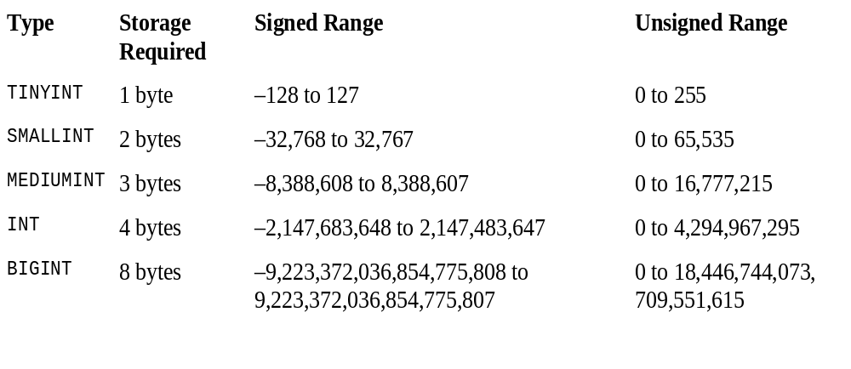
Numeric Data Types
Integer Data Types
Integer data types may be declared with a display width, which affects the number of digits used to display column values in query output. For example, assume that you declare an INT column with a display width of 4 like this:
century INT(4)
MySQL 5 Certification Study Guide

Slide 19
Numeric Data Types
Floating-Point Data Types
The floating-point data types include FLOAT and DOUBLE. Each of these types may be used to represent approximate-value numbers that have an integer part, a fractional part, or both.
You can specify explicit precision and scale values in the column definition to indicate the number of significant digits and the number of decimal places to the right of the decimal point. The following definitions specify a single-precision column with a precision of 10 digits and scale of 3 decimals, and a double-precision column with a precision of 20 digits and scale of 7 decimals:
  weight FLOAT(10,3)
  avg_score DOUBLE(20,7)
MySQL 5 Certification Study Guide

Slide 20
Numeric Data Types
Fixed-Point Data Types
The fixed-point data type is DECIMAL. It is used to represent exact-value numbers that have an integer part, a fractional part, or both.
DECIMAL columns may be declared with a precision and scale to indicate the number of significant digits and the number of decimal places to the right of the decimal point. For example, if you want to represent values such as dollar-and-cents currency figures, you can do so using a two-digit scale:
  cost DECIMAL(10,2)
MySQL 5 Certification Study Guide

Slide 21
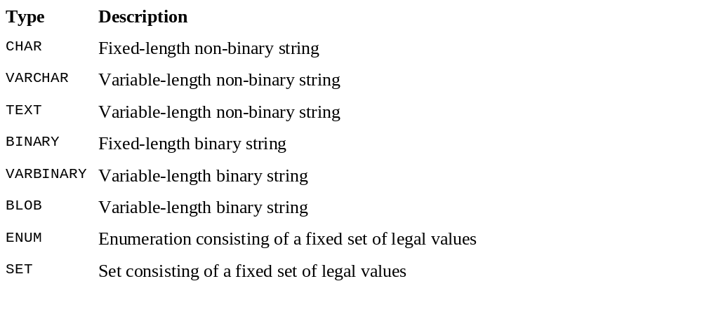
String Data Types
MySQL 5 Certification Study Guide

Slide 22
String Data Types
Non-binary And Binary Strings
A non-binary string is a sequence of characters that belong to a specific character set.
binary strings contain bytes, not characters, comparisons of binary strings are performed on the basis of the byte values in the string.
The following example shows the difference in how non-binary and binary strings are treated with respect to lettercase. The non-binary string is converted to uppercase by UPPER() because it contains characters for which lettercase applies. The binary string remains unchanged because it consists of byte values that have no lettercase.
  mysql> SELECT UPPER('AaBb'), UPPER(BINARY 'AaBb');
  +---------------+----------------------+
  | UPPER('AaBb') | UPPER(BINARY 'AaBb') |
  +---------------+----------------------+
  | AABB | AaBb |
  +---------------+----------------------+
MySQL 5 Certification Study Guide

Slide 23
String Data Types
The ENUM and SET Data Types
CREATE TABLE Countries(
name char(30),
continent ENUM (‘Asia’,’Europe’,’North America’,’Africa’, ‘Oceania’, ’Antarctica’, ’South America’)
);
INSERT INTO Countries (name,continent) VALUES(‘Kenya’,’Africa’);
CREATE TABLE allergy(symptom SET(‘sneezing’,’runny nose’,’stuffy head’,’red eyes’) );
INSERT INTO allergy (symptom) VALUES(‘’);
INSERT INTO allergy (symptom) VALUES(‘stuffy head’);
INSERT INTO allergy (symptom) VALUES(‘sneezing,red eyes’);
MySQL 5 Certification Study Guide

Slide 24
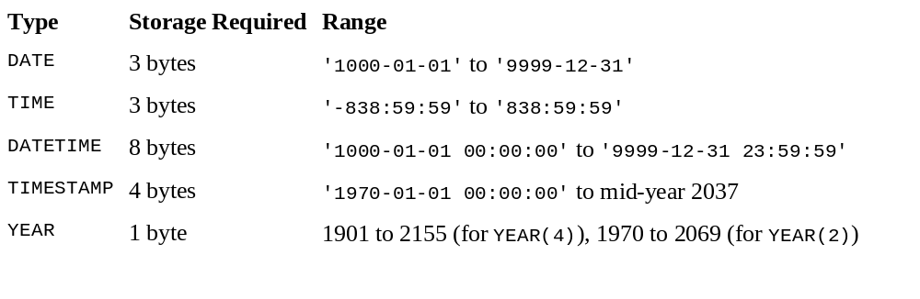
Temporal Data Types
MySQL 5 Certification Study Guide

Slide 25
Tables
Each MySQL server has a directory called the "data directory" under which it stores its databases. The data directory contains one subdirectory for each database managed by the server. Each of these is called a "database directory" and has the same name as the database that it represents. The server uses a given database directory to manage the tables in that database. Tables have both a logical and physical structure.
Logically, each table in a database consists of rows and columns. A table can be empty (it can have zero rows of data), but it must have at least one column. A table may also be indexed to improve query performance. Indexes enable MySQL to look up data values quickly rather than searching through the entire table. Indexes become increasingly important the larger a table becomes.
MySQL 5 Certification Study Guide

Slide 26
Tables
Physically, each table is associated with one or more files on disk. Every table has a format file in its database directory. The format file is created by the server and contains the definition, or structure, of the table. The format filename is the same as the table name, plus an .frm suffix. For example, the format file for a table named Country in the world database is named Country.frm and is located in the world database directory under the server's data directory.
MySQL manages tables using storage engines, each of which handles tables that have a given set of characteristics. Different storage engines have differing performance characteristics, and you can choose which engine most closely matches the characteristics that you need.
MySQL 5 Certification Study Guide

Slide 27
Tables
The MyISAM engine creates a data file and index file for each table. If Country is a MyISAM table, the MyISAM storage engine creates data and index files named Country.MYD and Country.MYI to store data rows and indexes (respectively) for the table.
By default, the InnoDB engine shares files for multiple tables. If Country is an InnoDB table, there will be a Country.frm format file created by the in the database directory, but the InnoDB storage engine itself stores the table data and index information elsewhere, in the InnoDB shared tablespace. The tablespace is used by multiple tables. That is, files for storing table contents are not per-table as for MyISAM but are shared among tables.
The MEMORY engine does not use any disk storage at all for table contents. It manages table contents in memory.
MySQL 5 Certification Study Guide

Slide 28
Creating Tables
To create a table, give its name followed by a list of column definitions within parentheses:
  CREATE TABLE table_name (column_definitions);
In the simplest case, a table contains only one column. The following statement creates a table named t with a single column named id that will contain INT (integer) values:
  CREATE TABLE t (id INT);
A column definition may include attributes that define the column data more precisely. For example, to disallow NULL values in the column, include NOT NULL in the definition:
  CREATE TABLE t (id INT NOT NULL);
If you try to create a table that already exists, an error occurs. If you simply want to ensure that the table exists, add an IF NOT EXISTS clause to the statement:
  CREATE TABLE IF NOT EXISTS t (i INT);
MySQL 5 Certification Study Guide

Slide 29
Creating Tables
More complex tables have multiple columns, with the column definitions separated by commas. The following table definition includes, in addition to an id column, two 30-character columns for storing last names and first names, and a column for storing date values. All columns are declared NOT NULL to indicate that they require non-NULL values.
  CREATE TABLE t
  (
  id INT NOT NULL,
  last_name CHAR(30) NOT NULL,
  first_name CHAR(30) NOT NULL,
  d DATE NOT NULL
  );
MySQL 5 Certification Study Guide

Slide 30
Altering Tables
After creating a table, you might discover that its structure is not quite suited to its intended use. If that happens, you can change the table's structure. One way to do this is to remove the table with DROP TABLE and then issue another CREATE TABLE statement that defines the table correctly. However, that can be a drastic method: If the table already contains data, dropping and re-creating the table destroys its contents unless you first make a backup. To change a table "in place," use the ALTER TABLE statement. The following list describes some of the modifications to a table's structure that ALTER TABLE makes possible:
  Adding or dropping columns
  Changing the name or definition of a column
  Adding or dropping indexes
  Renaming the table
MySQL 5 Certification Study Guide

Slide 31
Altering Tables
Assume the following table:
  CREATE TABLE HeadOfState
  (
  ID INT NOT NULL,
  LastName CHAR(30) NOT NULL,
  FirstName CHAR(30) NOT NULL
  );
The initial DESCRIBE output for the table looks like this:
  mysql> DESCRIBE HeadOfState;
  +-----------+----------+------+-----+---------+-------+
  | Field | Type | Null | Key | Default | Extra |
  +-----------+----------+------+-----+---------+-------+
  | ID | int(11) | NO | | | |
  | LastName | char(30) | NO | | | |
  | FirstName | char(30) | NO | | | |
  +-----------+----------+------+-----+---------+-------+
MySQL 5 Certification Study Guide

Slide 32
Altering Tables
Adding and Dropping Columns
  ALTER TABLE HeadOfState ADD Inauguration DATE NOT NULL;
  mysql> DESCRIBE HeadOfState;
  +--------------+----------+------+-----+---------+-------+
  | Field | Type | Null | Key | Default | Extra |
  +--------------+----------+------+-----+---------+-------+
  | ID | int(11) | NO | | | |
  | LastName | char(30) | NO | | | |
  | FirstName | char(30) | NO | | | |
  | Inauguration | date | NO | | | |
  +--------------+----------+------+-----+---------+-------+
  As shown by the DESCRIBE output, when you add a new column to a table, MySQL places it after all existing columns. This is the default placement unless you specify otherwise.
MySQL 5 Certification Study Guide

Slide 33
Altering Tables
To indicate that MySQL should place the new column in a specific position within the table, append either the keyword FIRST or the keyword-identifier combination AFTER column_name to the column definition. For example, assume that you had executed this ALTER TABLE statement instead of the previous one:
  ALTER TABLE HeadOfState ADD Inauguration DATE NOT NULL FIRST;
  mysql> DESCRIBE HeadOfState;
  +--------------+----------+------+-----+---------+-------+
  | Field | Type | Null | Key | Default | Extra |
  +--------------+----------+------+-----+---------+-------+
  | Inauguration | date | NO | | | |
  | ID | int(11) | NO | | | |
  | LastName | char(30) | NO | | | |
  | FirstName | char(30) | NO | | | |
  +--------------+----------+------+-----+---------+-------+
MySQL 5 Certification Study Guide

Slide 34
Altering Tables
Using AFTER column_name tells ALTER TABLE to place the new column after a specific existing column. For example, to place the new Inauguration column after the existing FirstName column, you would issue this statement:
  ALTER TABLE HeadOfState ADD Inauguration DATE NOT NULL AFTER FirstName;
  mysql> DESCRIBE HeadOfState;
  +--------------+----------+------+-----+---------+-------+
  | Field | Type | Null | Key | Default | Extra |
  +--------------+----------+------+-----+---------+-------+
  | ID | int(11) | NO | | | |
  | LastName | char(30) | NO | | | |
  | FirstName | char(30) | NO | | | |
  | Inauguration | date | NO | | | |
  +--------------+----------+------+-----+---------+-------+
MySQL 5 Certification Study Guide

Slide 35
Altering Tables
Modifying Existing Columns
There are two ways to change the definition of an existing column within a table. One of these also enables you to rename the column.
The first way to alter a column definition is to use a MODIFY clause.
ALTER TABLE HeadOfState MODIFY ID BIGINT UNSIGNED NOT NULL;
mysql> DESCRIBE HeadOfState;
+--------------+---------------------+------+-----+---------+-------+
| Field | Type | Null | Key | Default | Extra |
+--------------+---------------------+------+-----+---------+-------+
| ID | bigint(20) unsigned | NO | | | |
| LastName | char(30) | NO | | | |
| FirstName | char(30) | NO | | | |
| Inauguration | date | NO | | | |
+--------------+---------------------+------+-----+---------+-------+
MySQL 5 Certification Study Guide

Slide 36
Altering Tables
The second way to alter a column definition is to use a CHANGE clause. CHANGE enables you to modify both the column's definition and its name.
ALTER TABLE HeadOfState CHANGE LastName LastName CHAR(40) NOT NULL;
To change the name as well (for example, to Surname), provide the new name following the existing name:
ALTER TABLE HeadOfState CHANGE LastName Surname CHAR(40) NOT NULL;
Renaming a Table
Renaming a table changes neither a table's structure nor its contents. The following statement renames table t1 to t2:
ALTER TABLE t1 RENAME TO t2;
Another way to rename a table is by using the RENAME TABLE statement:
RENAME TABLE t1 TO t2;
RENAME TABLE has an advantage over ALTER TABLE in that it can perform multiple table renames in a single operation. One use for this feature is to swap the names of two tables:
RENAME TABLE t1 TO tmp, t2 TO t1, tmp TO t2;
MySQL 5 Certification Study Guide

Slide 37
Altering Tables
Specifying Multiple Table Alterations
You can specify multiple alterations for a table with a single ALTER TABLE statement
ALTER TABLE HeadOfState RENAME TO CountryLeader,
MODIFY ID BIGINT UNSIGNED NOT NULL,
ADD Salutation CHAR(30) NULL AFTER FirstName;
Altering Tables Examples
convert a table to be an InnoDB table,
ALTER TABLE t1 ENGINE = InnoDB;
Drop multiple columns in a single statement,
ALTER TABLE t2 DROP COLUMN c, DROP COLUMN d;
Rename an INTEGER column from a to b,
ALTER TABLE t1 CHANGE a b INTEGER;
ALTER TABLE t1 CHANGE b b BIGINT NOT NULL;
ALTER TABLE t1 MODIFY b BIGINT NOT NULL;
ALTER TABLE t1 MODIFY col1 BIGINT;
MySQL 5 Certification Study Guide

Slide 38
Dropping Tables
To remove a table when you no longer need it, use the DROP TABLE statement:
DROP TABLE t;
In MySQL, a single DROP TABLE statement can name several tables to be dropped simultaneously:
DROP TABLE t1, t2, t3;
Normally, an error occurs if you attempt to drop a table that does not exist:
mysql> DROP TABLE no_such_table;
ERROR 1051 (42S02): Unknown table 'no_such_table‘
mysql> DROP TABLE IF EXISTS no_such_table;
Query OK, 0 rows affected, 1 warning (0.00 sec)
MySQL 5 Certification Study Guide

Slide 39
Table Constrains
Defining a Column’s Nullability
A column’s nullability refers to a column’s ability to accept null values.
CREATE TABLE Catalog(
ProductID SMALLINT UNSIGNED NOT NULL,
Name VARCHAR(40) NOT NULL
);
Defining Default Values
CREATE TABLE AuthorBios(
AuthID SMALLINT UNSIGNED NOT NULL,
YearBorn YEAR NOT NULL,
CityBorn varchar NOT NULL DEFAULT ‘Unknown’
);
CREATE TABLE AuthorBios(
AuthID SMALLINT UNSIGNED NOT NULL,
YearBorn YEAR NOT NULL,
NumBooks SMALLINT NOT NULL DEFAULT 1
);
Beginning MySQL <number>

Slide 40
Table Constrains
Defining Primary Keys
CREATE TABLE Orders
(
OrderID SMALLINT UNSIGNED PRIMARY KEY,
ModelID SMALLINT UNSIGNED NOT NULL,
ModelDescrip VARCHAR(40)
);
CREATE TABLE Orders
(
OrderID SMALLINT UNSIGNED NOT NULL,
ModelID SMALLINT UNSIGNED NOT NULL,
ModelDescrip VARCHAR(40),
PRIMARY KEY (OrderID, ModelID)
);
Beginning MySQL <number>

Slide 41
Table Constrains
Defining Auto-Increment Columns
CREATE TABLE mytbl
(
seq INT UNSIGNED AUTO_INCREMENT NOT NULL,
PRIMARY KEY (seq)
)
To insert into this table:
INSERT into mytbl values();
To select the rows:
Select * from mytbl;
You can change the current sequence counter for an existing table with ALTER TABLE.
ALTER TABLE mytbl AUTO_INCREMENT = 2000;
What the difference:
DESCRIBE mytbl;
SHOW TABLE STATUS LIKE 'mytbl';
Beginning MySQL & Sams-Mysql <number>

Slide 42


Table Constrains
Adding a Sequence Number Column to a Table
Suppose you create a table and put some information into it:
mysql> CREATE TABLE t (c CHAR(10));
mysql> INSERT INTO t VALUES('a'),('b'),('c');
mysql> SELECT * FROM t;
Then you decide that you want to include a sequence number column in the table. To do this, issue an ALTER TABLE statement to add an AUTO_INCREMENT column, using the same kind of type definition that you'd use with CREATE TABLE:
mysql> ALTER TABLE t ADD i INT AUTO_INCREMENT NOT NULL PRIMARY KEY;
mysql> SELECT * FROM t;
Sams-Mysql <number>

Slide 43

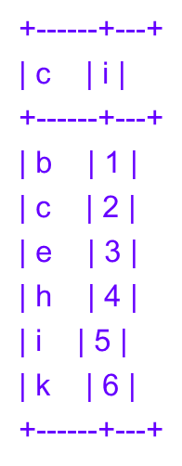
Table Constrains
Resequencing an Existing Column
If a table already has an AUTO_INCREMENT column but you want to renumber it to eliminate gaps in the sequence that may have resulted from row deletions, the easiest way to do it is to drop the column and then add it again.
Suppose a table t looks like the following, where i is the AUTO_INCREMENT column:
mysql> CREATE TABLE t (c CHAR(10), i INT NOT NULL AUTO_INCREMENT PRIMARY KEY);
mysql> INSERT INTO t (c)
-> VALUES('a'),('b'),('c'),('d'),('e'),('f'),('g'),('h'),('i'),('j'),('k');
mysql> DELETE FROM t WHERE c IN('a','d','f','g','j');
mysql> SELECT * FROM t;
The following ALTER TABLE statement drops the column
and then adds it again:
mysql> ALTER TABLE t
-> DROP i,
-> ADD i INT UNSIGNED AUTO_INCREMENT NOT NULL,
-> AUTO_INCREMENT = 1;
mysql> SELECT * FROM t;
Sams-Mysql <number>

Slide 44

Table Constrains
Starting a Sequence at a Particular Value
Sequences start at 1, but you want to use a different starting value. For MyISAM tables,
mysql> CREATE TABLE t
-> (id INT UNSIGNED NOT NULL AUTO_INCREMENT, PRIMARY KEY (id))
-> AUTO_INCREMENT = 100;
mysql> INSERT INTO t (id) VALUES(NULL);
mysql> INSERT INTO t (id) VALUES(NULL);
mysql> INSERT INTO t (id) VALUES(NULL);
mysql> SELECT id FROM t ORDER BY id;
To start a sequence at n for table types other than MyISAM, you must use a hack: insert a "fake" record with sequence value n-1, then delete it after inserting one or more "real" records.
mysql> CREATE TABLE t
-> (id INT UNSIGNED NOT NULL AUTO_INCREMENT, PRIMARY KEY (id))
-> TYPE = InnoDB;
mysql> INSERT INTO t (id) VALUES(99);
mysql> INSERT INTO t (id) VALUES(NULL);
mysql> INSERT INTO t (id) VALUES(NULL);
mysql> INSERT INTO t (id) VALUES(NULL);
mysql> DELETE FROM t WHERE id = 99;
mysql> SELECT * FROM t ORDER BY id;
MySQL Cookbook <number>

Slide 45
Table Constrains
Defining Foreign Keys
CREATE TABLE Orders
(
OrderID SMALLINT UNSIGNED NOT NULL PRIMARY KEY,
Mid SMALLINT UNSIGNED NOT NULL REFERENCES Models (ModelID),
ModelDescrip VARCHAR(40)
);
Create table Models (
ModelID smallint primary key
);
CREATE TABLE Orders
(
OrderID SMALLINT UNSIGNED NOT NULL PRIMARY KEY,
Mid SMALLINT UNSIGNED NOT NULL,
ModelDescrip VARCHAR(40),
FOREIGN KEY (Mid) REFERENCES Models (ModelID)
ON DELETE CASCADE ON UPDATE CASCADE
);
The difference between this example and the last example is that the reference definition in the last example includes an ON DELETE clause and an ON UPDATE clause, both of which are configured with the CASCADE option. As a result, the child table reflects changes to the parent table.
Beginning MySQL <number>

Slide 46
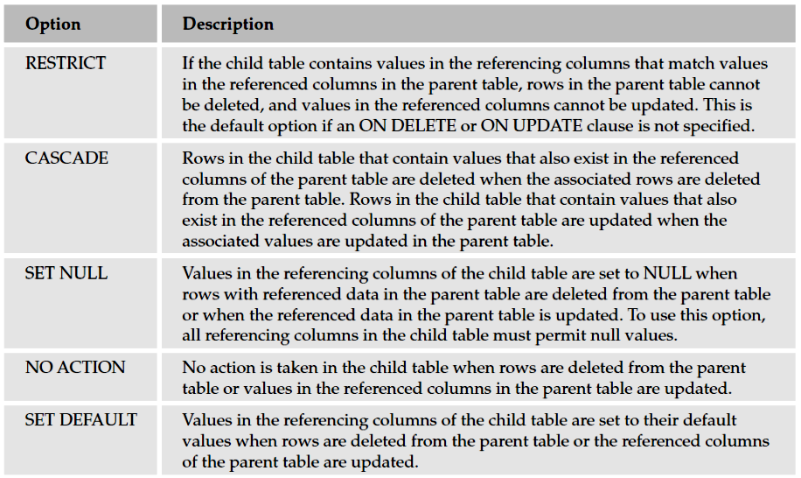
Table Constrains
The ON DELETE clause specifies how MySQL treats related data in the child table when a row in the parent table is deleted. The ON UPDATE clause specifies how MySQL treats related data in the child table when a row in the parent table is updated. For each clause, five options are available. You can specify only one option for each clause. These options are described in the following table:
Beginning MySQL <number>

Slide 47
Table Constrains
Let's see an example of how all this works. Begin by creating tables named parent and child, such that the child table contains a foreign key that references the par_id column in the parent table:
CREATE TABLE parent
(
par_id INT NOT NULL,
PRIMARY KEY (par_id)
) TYPE = INNODB;
CREATE TABLE child
(
par_id INT NOT NULL,
child_id INT NOT NULL,
PRIMARY KEY (par_id, child_id),
FOREIGN KEY (par_id) REFERENCES parent (par_id) ON DELETE CASCADE
) TYPE = INNODB;
The foreign key in this case uses ON DELETE CASCADE to specify that when a record is deleted from the parent table, child records with a matching par_id value should be removed automatically as well.
Sams-Mysql <number>

Slide 48
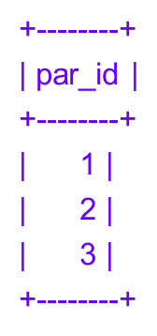
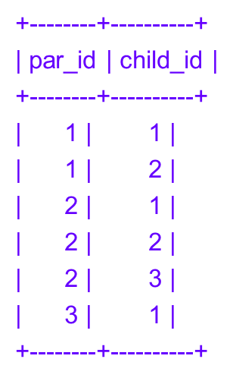
Table Constrains
Now insert a few records into the parent table and add some records that have related key values to the child table:
mysql> INSERT INTO parent (par_id) VALUES(1),(2),(3);
mysql> INSERT INTO child (par_id,child_id) VALUES(1,1),(1,2);
mysql> INSERT INTO child (par_id,child_id) VALUES(2,1),(2,2),(2,3);
mysql> INSERT INTO child (par_id,child_id) VALUES(3,1);
These statements result in the following table contents, where each par_id value in the child table matches a par_id value in the parent table:
mysql> SELECT * FROM parent; mysql> SELECT * FROM child;
Sams-Mysql <number>

Slide 49
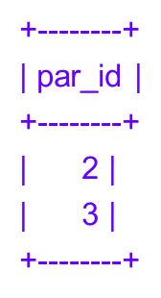
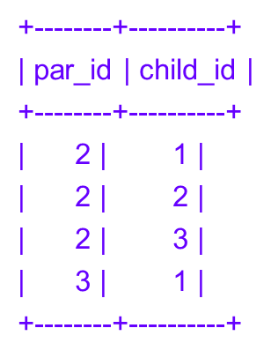
Table Constrains
To verify that InnoDB enforces the key relationship for insertion, try adding a record to the child table that has a par_id value not found in the parent table:
mysql> INSERT INTO child (par_id,child_id) VALUES(4,1);
ERROR 1216: Cannot add a child row: a foreign key constraint fails
Now see what happens when you delete a parent record:
mysql> DELETE FROM parent where par_id = 1;
MySQL deletes the record from the parent table:
mysql> SELECT * FROM parent;
In addition, it cascades the effect of the DELETE statement to the child table:
mysql> SELECT * FROM child;
Sams-Mysql <number>

Slide 50
Indexes
Tables in MySQL can grow very large, but as a table gets bigger, retrievals from it become slower. To keep your queries performing well, it's essential to index your tables. Indexes allow column values to be found more efficiently, so retrievals based on indexes are faster than those that are not. For large tables, the presence of an index can make the difference between a query that executes quickly and one that is unacceptably slow.
Another reason to use indexes is that they can enforce uniqueness constraints to ensure that duplicate values do not occur and that each row in a table can be distinguished from every other row.
Types of Indexes
MySQL supports three general types of indexes:
A primary key is an index for which each index value differs from every other and uniquely identifies a single row in the table. A primary key cannot contain NULL values.
A unique index is similar to a primary key, except that it can be allowed to contain NULL values. Each non-NULL value uniquely identifies a single row in the table.
A non-unique index is an index in which any key value may occur multiple times.
MySQL 5 Certification Study Guide <number>

Slide 51
Indexes
Creating Indexes
To create the table with the same columns but with a non-unique index on the date-valued column Inauguration, include an INDEX clause in the CREATE TABLE statement as follows:
CREATE TABLE HeadOfState
(
ID INT NOT NULL,
LastName CHAR(30) NOT NULL,
FirstName CHAR(30) NOT NULL,
CountryCode CHAR(3) NOT NULL,
Inauguration DATE NOT NULL,
INDEX (Inauguration)
);
The keyword KEY may be used instead of INDEX.
MySQL 5 Certification Study Guide <number>

Slide 52
Indexes
To include multiple columns in an index (that is, to create a composite index), list all the column names within the parentheses, separated by commas. For example, a composite index that includes both the LastName and FirstName columns can be defined as follows:
CREATE TABLE HeadOfState
(
ID INT NOT NULL,
LastName CHAR(30) NOT NULL,
FirstName CHAR(30) NOT NULL,
CountryCode CHAR(3) NOT NULL,
Inauguration DATE NOT NULL,
INDEX (LastName, FirstName)
);
MySQL 5 Certification Study Guide <number>

Slide 53
Indexes
To create a unique-valued index, use the UNIQUE keyword instead of INDEX. For example, if you want to prevent duplicate values in the ID column, create a UNIQUE index for it like this:
CREATE TABLE HeadOfState
(
ID INT NOT NULL,
LastName CHAR(30) NOT NULL,
FirstName CHAR(30) NOT NULL,
CountryCode CHAR(3) NOT NULL,
Inauguration DATE NOT NULL,
UNIQUE (ID)
);
There's one exception to the uniqueness of values in a UNIQUE index: If a column in the index may contain NULL values, multiple NULL values are allowed. This differs from the behavior for non-NULL values.
A PRIMARY KEY is similar to a UNIQUE index. The differences between the two are as follows:
A PRIMARY KEY cannot contain NULL values; a UNIQUE index can. If a unique-valued index must be allowed to contain NULL values, you must use a UNIQUE index, not a PRIMARY KEY.
Each table may have only one index defined as a PRIMARY KEY. (The internal name for a PRIMARY KEY is always PRIMARY, and there can be only one index with a given name.) It's possible to have multiple UNIQUE indexes for a table.
MySQL 5 Certification Study Guide <number>

Slide 54
Indexes
Dropping Indexes
To drop an index from a table, use ALTER TABLE or DROP INDEX.
With ALTER TABLE, use a DROP clause and name the index to be dropped. Dropping a PRIMARY KEY is easy:
ALTER TABLE HeadOfState DROP PRIMARY KEY;
To drop another kind of index, you must specify its name. If you don't know the name, you can use SHOW CREATE TABLE to see the table's structure, including any index definitions, as shown here:
mysql> SHOW CREATE TABLE HeadOfState\G
*************************** 1. row ***************************
Table: HeadOfState
Create Table: CREATE TABLE `HeadOfState` (
`ID` int(11) NOT NULL default '0',
`LastName` char(30) NOT NULL default '',
`FirstName` char(30) NOT NULL default '',
`CountryCode` char(3) NOT NULL default '',
`Inauguration` date NOT NULL default '0000-00-00',
KEY `NameIndex` (`LastName`,`FirstName`)
) ENGINE=MyISAM DEFAULT CHARSET=latin1
The KEY clause of the output shows that the index name is NameIndex, so you can drop the index using the following statement:
ALTER TABLE HeadOfState DROP INDEX NameIndex;
MySQL 5 Certification Study Guide <number>

Slide 55
Indexes
To drop an index with DROP INDEX, indicate the index name and table name:
DROP INDEX NameIndex ON t;
To drop a PRIMARY KEY with DROP INDEX, refer to the index name (PRIMARY), but use a quoted identifier because this name is a reserved word:
DROP INDEX `PRIMARY` ON t;
Unlike ALTER TABLE, the DROP INDEX statement can drop only on a single index per statement.
MySQL 5 Certification Study Guide <number>

Slide 56
Updating Data
The statements covered in this section modify the contents of database tables.
  Insert Data
  Modify Data
  Delete Data
Much of the discussion in this section uses the following table as a source of examples:
CREATE TABLE people
(
id INT UNSIGNED NOT NULL AUTO_INCREMENT,
name CHAR(40) NOT NULL DEFAULT '',
age INT NOT NULL DEFAULT 0,
PRIMARY KEY (id)
);
MySQL 5 Certification Study Guide <number>

Slide 57
Updating Data
The INSERT Statement
The INSERT statement adds new records to a table. It has two basic formats, one of which allows for insertion of multiple rows using a single statement:
The first syntax for INSERT uses separate column and value lists following the name of the table into which you want to add the record.
INSERT INTO people (id,name,age) VALUES(12,'William',25);
The second INSERT syntax follows the table name by a SET clause that lists individual column assignments separated by commas:
INSERT INTO people SET id = 12, name = 'William', age = 25;
Adding Multiple Records with a Single INSERT Statement
INSERT INTO people (name,age) VALUES('William',25),('Bart',15),('Mary',12);
Handling Duplicate Key Values
If a table has a unique-valued index, it might not be possible to use INSERT to add a given record to the table. This happens when the new record contains a key value for the index that's already present in the table. Suppose that every person in the people table has a unique value in the id column. If an existing record has an id value of 347 and you attempt to insert a new record that also has an id of 347, it duplicates an existing key value.
MySQL 5 Certification Study Guide <number>

Slide 58
Updating Data
MySQL provides three ways to deal with duplicate values in a unique-valued index when adding new records to a table with INSERT:
If you don't indicate explicitly how to handle a duplicate, MySQL aborts the statement with an error and discards the new record. This is the default behavior.
You can tell MySQL to ignore the new record without producing an error. To do this, modify the statement so that it begins with INSERT IGNORE rather than with INSERT. If the record does not duplicate a unique key value, MySQL inserts it as usual. If the record does contain a duplicate key, MySQL ignores it. Client programs that terminate on statement errors will abort with INSERT but not with INSERT IGNORE.
You can use the ON DUPLICATE KEY UPDATE clause to update specific columns of the existing record.
Using INSERT ... ON DUPLICATE KEY UPDATE
mysql> CREATE TABLE log (
-> name CHAR(30) NOT NULL,
-> location CHAR(30) NOT NULL,
-> counter INT UNSIGNED NOT NULL,
-> PRIMARY KEY (name, location));
MySQL 5 Certification Study Guide <number>

Slide 59
Updating Data
mysql> INSERT INTO log (name, location, counter)
-> VALUES ('Tantor', 'Waterhole', 1)
-> ON DUPLICATE KEY UPDATE counter=counter+1;
mysql> SELECT * FROM log;
+--------+-----------+---------+
| name | location | counter |
+--------+-----------+---------+
| Tantor | Waterhole | 1 |
+--------+-----------+---------+
mysql> INSERT INTO log (name, location, counter)
-> VALUES ('Tantor', 'Waterhole', 1)
-> ON DUPLICATE KEY UPDATE counter=counter+1;
mysql> SELECT * FROM log;
+--------+-----------+---------+
| name | location | counter |
+--------+-----------+---------+
| Tantor | Waterhole | 2 |
+--------+-----------+---------+
MySQL 5 Certification Study Guide <number>

Slide 60
Updating Data
The REPLACE Statement
The REPLACE statement, like INSERT, add new records to a table. The two statements have very similar syntax.
The primary difference between them lies in how they handle duplicate records.
Also, REPLACE does not support the ON DUPLICATE KEY UPDATE clause.
REPLACE is like INSERT except that it deletes old records as necessary when a duplicate unique key value is present in a new record. Suppose that you're inserting a record into the people table, which has id as a PRIMARY KEY:
  If the new record doesn't duplicate an existing id value, MySQL just inserts it.
  If the new record does duplicate an existing id value, MySQL first deletes any old records containing that value before inserting the new record.
REPLACE statement syntax is similar to that for INSERT. The following are each valid forms of REPLACE. They're analogous to examples shown earlier in the chapter for INSERT:
A single-record REPLACE with separate column and value lists:
REPLACE INTO people (id,name,age) VALUES(12,'William',25);
A multiple-record REPLACE that inserts several rows:
REPLACE INTO people (id,name,age)
VALUES(12,Ahmed',30),(13,'Bart',15),(14,'Mary',12);
MySQL 5 Certification Study Guide <number>

Slide 61
Updating Data
If a table contains multiple unique-valued indexes, a new record added with REPLACE might cause duplicate-key violations for multiple existing records. In this case, REPLACE replaces each of those records. The following table has three columns, each of which has a UNIQUE index:
CREATE TABLE multikey
(
i INT NOT NULL UNIQUE,
j INT NOT NULL UNIQUE,
k INT NOT NULL UNIQUE
);
Suppose that the table has these contents:
mysql> SELECT * FROM multikey;
+---+---+---+
| i | j | k |
+---+---+---+
| 1 | 1 | 1 |
| 2 | 2 | 2 |
| 3 | 3 | 3 |
| 4 | 4 | 4 |
+---+---+---+
MySQL 5 Certification Study Guide <number>

Slide 62
Updating Data
Using REPLACE to add a record that duplicates a row in each column causes several records to be replaced with the new row:
mysql> REPLACE INTO multikey (i,j,k) VALUES(1,2,3);
Query OK, 4 rows affected (0.00 sec)
mysql> SELECT * FROM multikey;
+---+---+---+
| i | j | k |
+---+---+---+
| 1 | 2 | 3 |
| 4 | 4 | 4 |
+---+---+---+
The REPLACE statement reports a row count of four because it deletes three records and inserts one.
MySQL 5 Certification Study Guide <number>

Slide 63
Updating Data
The UPDATE Statement
UPDATE people SET age = 30 WHERE id = 12;
To update multiple columns, separate the column value assignments in the SET clause by commas:
UPDATE people SET age = 30, name = 'Wilhelm' WHERE id = 12;
Using UPDATE with ORDER BY and LIMIT
mysql> SELECT * FROM people;
+----+--------+------+
| id | name | age |
+----+--------+------+
| 2 | Victor | 21 |
| 3 | Susan | 15 |
+----+--------+------+
If you want to renumber the id values to begin at 1, you might issue this UPDATE statement:
UPDATE people SET id = id - 1;
The statement succeeds if it updates id values first by setting 2 to 1 and then 3 to 2. However, it fails if it first tries to set 3 to 2. That would result in two records having an id value of 2, so a duplicate-key violation occurs. To solve this problem, add an ORDER BY clause to cause the row updates to occur in a particular order:
MySQL 5 Certification Study Guide <number>

Slide 64
Updating Data
To solve this problem, add an ORDER BY clause to cause the row updates to occur in a particular order:
UPDATE people SET id = id - 1 ORDER BY id;
UPDATE also allows a LIMIT clause, which places a limit on the number of records updated. For example, if you have two identical people records with a name value of 'Nicolas' and you want to change just one of them to 'Nick', use this statement:
UPDATE people SET name = 'Nick' WHERE name = 'Nicolas' LIMIT 1;
MySQL 5 Certification Study Guide <number>

Slide 65
Updating Data
The DELETE and truncate TABLE Statements
To remove records from tables, use a DELETE statement or a trUNCATE TABLE statement. The DELETE statement allows a WHERE clause that identifies which records to remove, whereas TRUNCATE TABLE always removes all records. DELETE therefore can be more precise in its effect.
To empty a table entirely by deleting all its records, you can use either of the following statements:
DELETE FROM table_name;
TRUNCATE TABLE table_name;
The word TABLE in TRUNCATE TABLE is optional.
The following comparison summarizes the differences between DELETE and TRUNCATE TABLE:
DELETE:
Can delete specific rows from a table if a WHERE clause is included
Usually executes more slowly
Returns a true row count indicating the number of records deleted
truncate TABLE:
Cannot delete just certain rows from a table; always completely empties it
Usually executes more quickly
Returns a row count of zero rather than the actual number of records deleted
MySQL 5 Certification Study Guide <number>

Slide 66
Updating Data
Using DELETE with ORDER BY and LIMIT
DELETE FROM people WHERE name = 'Emily' LIMIT 4;
DELETE FROM people WHERE name = 'Emily' ORDER BY id DESC LIMIT 4;
Multiple-Table UPDATE and DELETE Statements
For example, this statement identifies matching records in two tables based on id values, and then copies the name column from t2 to t1:
UPDATE t1, t2 SET t1.name = t2.name WHERE t1.id = t2.id;
Multiple-table DELETE statements can be written in two formats. The following example demonstrates one syntax, for a query that deletes rows from a table t1 where the id values match those in a table t2:
DELETE t1 FROM t1, t2 WHERE t1.id = t2.id;
The second syntax is slightly different:
DELETE FROM t1 USING t1, t2 WHERE t1.id = t2.id;
To delete the matching records from both tables, the statements are:
DELETE t1, t2 FROM t1, t2 WHERE t1.id = t2.id;
DELETE FROM t1, t2 USING t1, t2 WHERE t1.id = t2.id;
MySQL 5 Certification Study Guide <number>

